Slide 1

Unequal Responsibilities, Unequal Risks: How Income Shapes CO₂ Emissions and Climate Vulnerability
A Data-Driven Exploration of Historic Emissions, Economic Efficiency, Energy Mix, and Climate Risk Across Low-, Middle-, and High-Income Countries
Prepared by Adam marchakitus

Slide 2
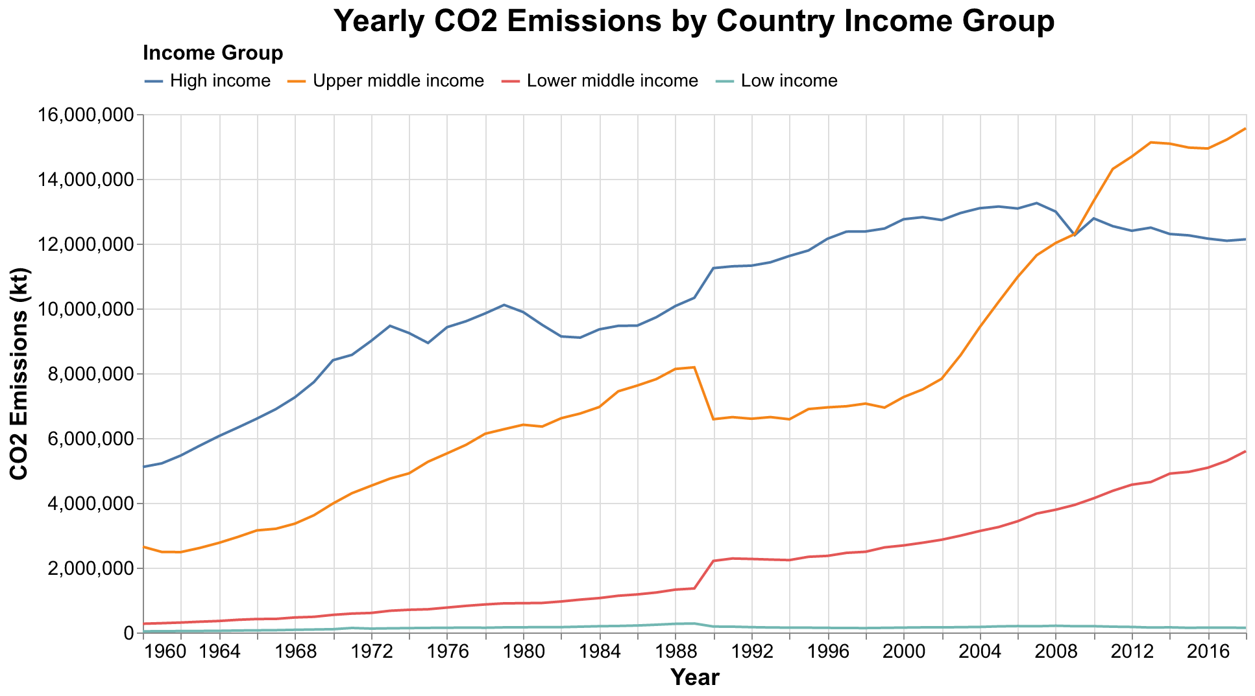
High-Income Countries Have Contributed the Most to Global Carbon Emissions

Slide 3
Until 2008, high-income countries have emitted the largest amounts of CO2
However, upper-middle income countries, like China, Mexico, and South Africa begin to outpace high income countries like the United States and EU Member States

Slide 4
2008 financial crisis
CO2 emissions are heavily tied to major economic events
1973 Energy Crisis
Early 1980s recession
Fall of Communism

Slide 5
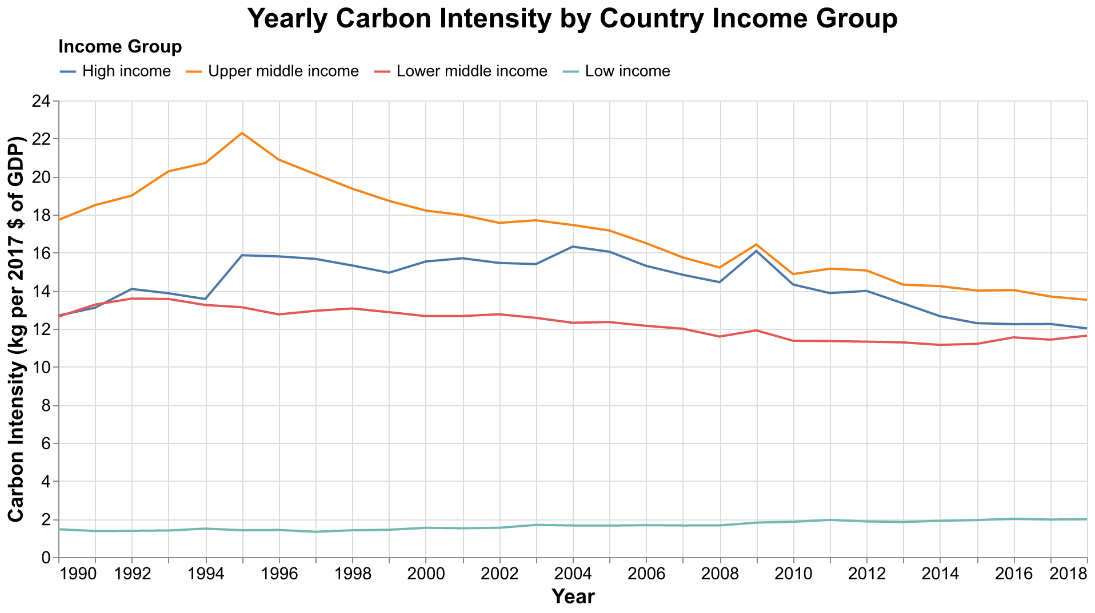
Decoupling or Not? Tracking CO₂ Emissions per Unit of GDP Across Income Levels

Slide 6
Are these countries improving the efficiency of their economies?
Efficiency—the amount of CO2 emitted per dollar of economic output—is outpacing industrialization overall. Most countries display a gradual decline in carbon intensity, despite the post-2009 energy boom in upper-middle income countries. Yet, low-income nations display far less carbon intensity.

Slide 7
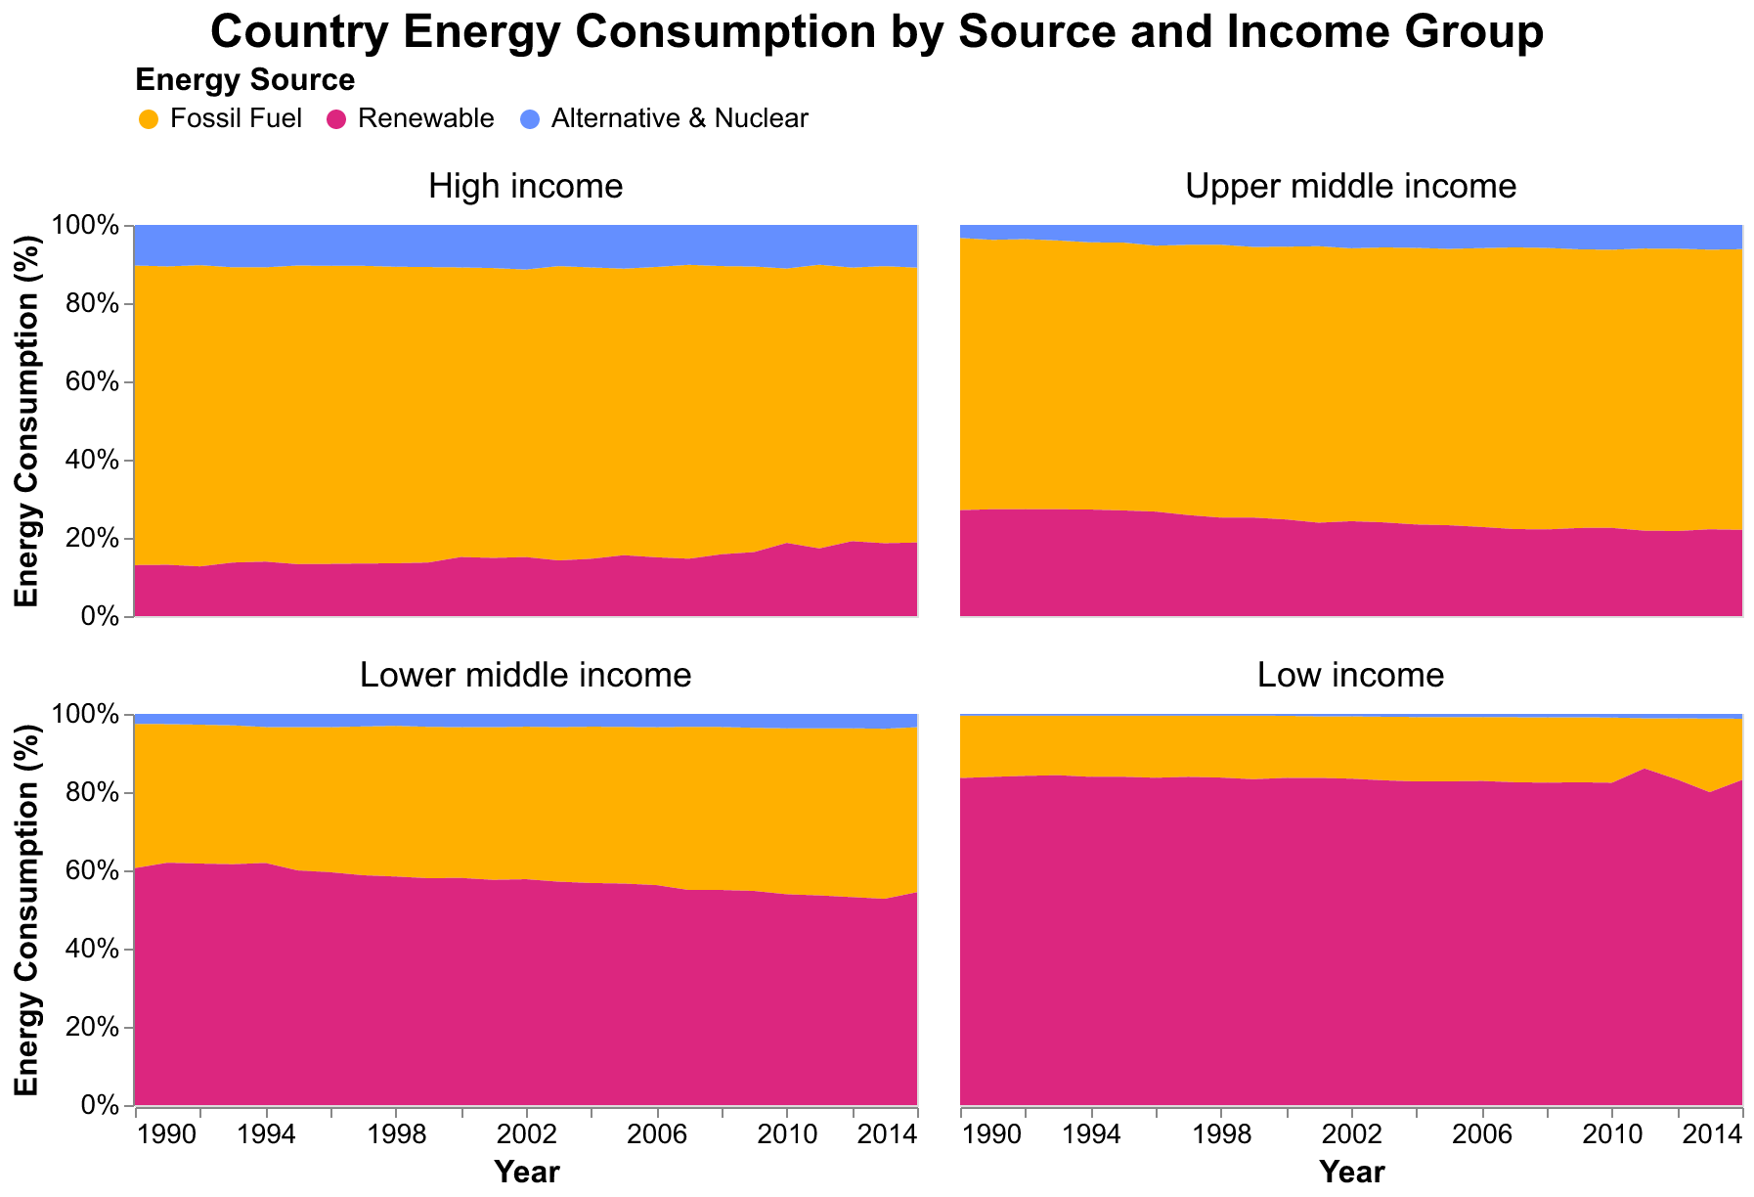
Fossil Fuels vs. Renewables: The Largely Invariant Energy Portfolios of Low-, Middle-, and High-Income Nations

Slide 8
Higher-income countries maintain a heavy reliance on fossil fuels and see little growth in the renewable energy sector

Slide 10
Lower-income countries see a much greater share of their energy sourced from renewables, although their production is less overall

Slide 11
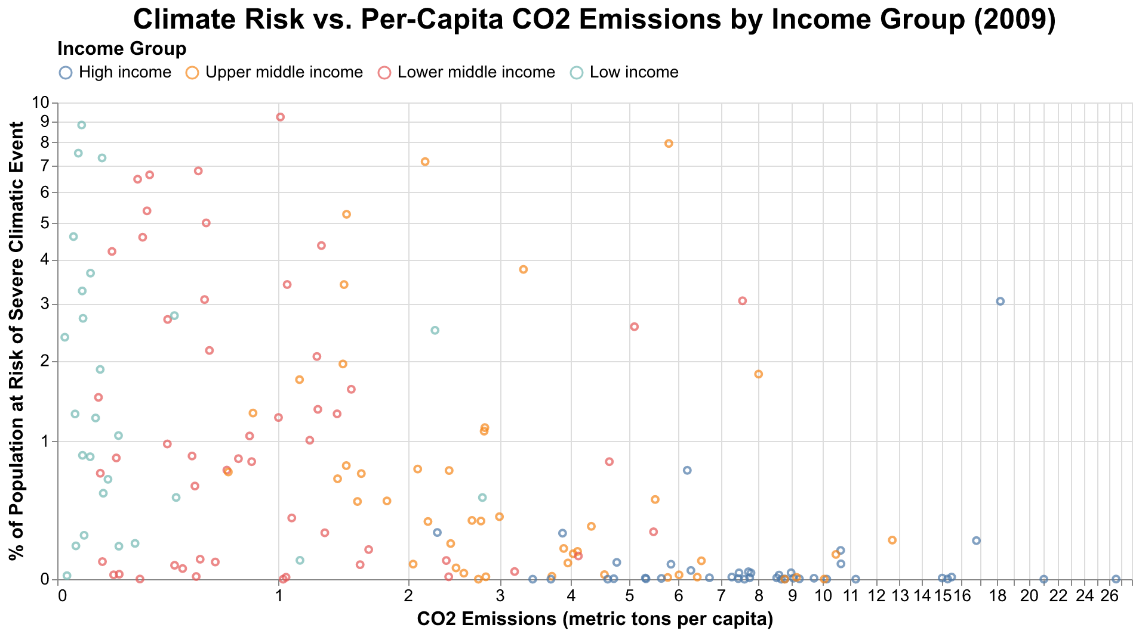
Climate Inequity: those with higher emissions are not always those who experience the worst effects.

Slide 13
Low-income countries, despite their minimal contributions to global emissions, face the highest climate risks and stand to be most impacted by an increasingly variable climate.

Slide 14
Data Sources
World Bank Data by Indicators 1960-2020, via light-and-salt (2020) https://github.com/light-and-salt/World-Bank-Data-by-Indicators

